Slide 1
Cloud Robotics: Building Smarter Robots with the Cloud PRESENTED BY VISHALI P (1925242313) TECHNICAL PRESENTATION

Slide 2
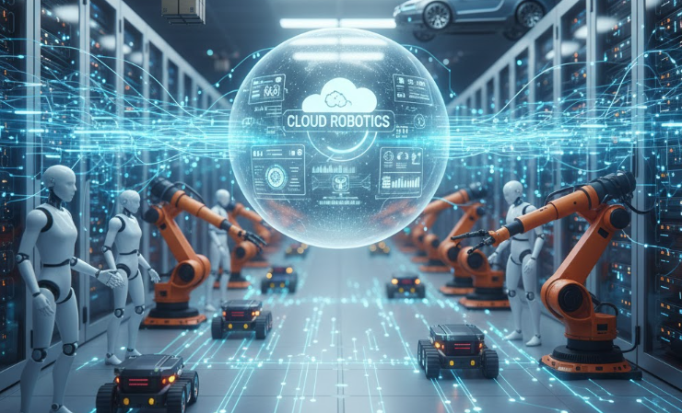
INTRODUCTION:
Cloud Robotics is a combination of Robotics and Cloud Computing.
Robots connect to the cloud through the internet.
The cloud helps robots store data and make better decisions.
This makes robots smarter and more efficient.

Slide 3
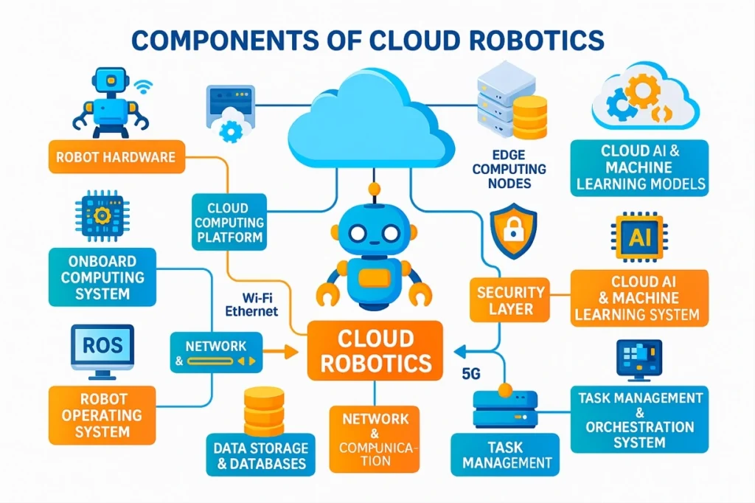
How Cloud Robotics Works
Robot collects data using sensors and cameras.
Data is sent to the cloud.
The cloud processes the data.
The cloud sends the result back.
The robot performs the task.
Flow: Robot → Internet → Cloud → Robot

Slide 4
COMPONENTS
Robot
Sensors
Camera
Controller
Internet
Connects the robot to the cloud.
Cloud
Stores data.
Processes information.
Runs AI programs.

Slide 5
APPLICATIONS
Healthcare – Hospital robots
Factories – Assembly robots
Warehouses – Product picking robots
Agriculture – Crop monitoring robots
Delivery – Food and parcel delivery robots

Slide 6
BENEFITS
Fast data processing
Less storage needed in robots
Easy software updates
Remote monitoring
Low cost
Better performance

Slide 7
CONCLUSION
Cloud Robotics combines robots with cloud computing.
It makes robots smarter and more efficient.
It is widely used in healthcare, industries, agriculture, and logistics.
It has a bright future with AI and cloud technology.

Slide 8
THANK YOU

